Slide 1
Multi Client Chatroom

Slide 2
1
What is multi client chat server?
Table of
contant
2
Sockets
3
server

Slide 3

What is multi Client chat server?
In multi client chat server, Most clients are connected to a server and send messages.
When a client want to communication, one of the clients send messages to the server
Server send back the messages to all other clients.
When client send message all other client see it message.

Slide 4
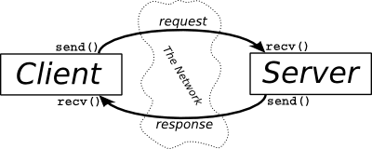
Continue…

Slide 5
Socket
In the previous lessons we know more about socket . Socket helps us to communicate with the different hosts in a network.
a multi users chat application runs a socket programming.
Chat applications like medical interface.
In the client-Server modal every server has unique IP Address and port number.
Client make connection with server by this port number and IP Address .

Slide 6

Server and client
Server is a process which waits for clients requests when client send request to server so server returns the result of it request.
Client : is a process that initiate a service request.

Slide 7
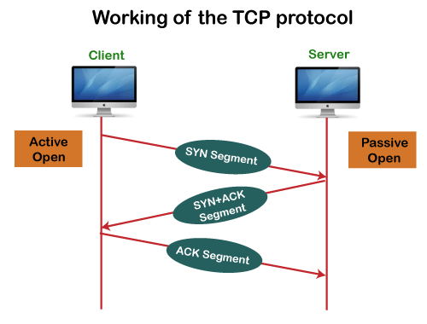
TCP Protocol
TCP Protocol….
It is ( Transmission control protocol) and TCP is reliable control protocol before sending data between client and server TCP make connection. TCP is responsible bit Data sending when did not send TCP send it again.
It is use FTP , SMP protocols

Slide 8
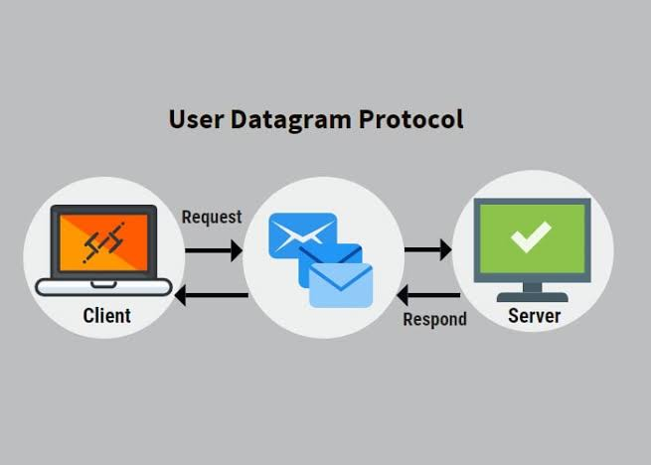
UDP Protocol
UDP Protocol…
( Use Datagram protocol) it is communication protocol send data to sever it does not know by sending more when data damage in way or not send UDP is irresponsible a bout that.

Slide 9
?

Slide 10
THANKS FOR YOUR
WATCHING

